Slide 1



Amazon-Sales Report Analysis
Conduct a comprehensive analysis of Amazon sales data to extract actionable insights that support business decision-making.
Notes:
Source images : Powerpoint Stock Images

Slide 2

Problem Description
Analyze and Provide Insights on Amazon Sales Report
The dataset provided includes detailed information about sales transactions on Amazon, covering various aspects such as order ID, date, status, fulfillment method, sales channel, product category, size, quantity, amount, and shipping details. The objective is to perform a comprehensive analysis of this data to extract actionable insights that can inform business decisions.
Notes:
Source images : Powerpoint Stock Images

Slide 3

Sales Overview
Product Analysis
Key
Objectives
Fulfillment Analysis
Customer Segmentation
Geographical Analysis
Business Insights
Notes:
Source images : Powerpoint Stock Images

Slide 4

Overview
Sales Overview
To understand the overall sales performance, trends, and patterns over time.
Product Analysis
To analyze the distribution of product categories, sizes, and quantities sold to identify popular products.
Fulfillment
Analysis:
To investigate the fulfillment methods used and their effectiveness in delivering orders.
Customer Segmentation
To segment customers based on their buying behavior, location, and other relevant factors.
Geographical Analysis
To explore the geographical distribution of sales, focusing on states and cities.
Notes:
Source images : Powerpoint Stock Images

Slide 5

Deliverables
Reports
A comprehensive analysis report summarizing key findings, insights, and recommendations.
Visualizations (charts, graphs) illustrating various aspects of the data analysis.
Insights on product preferences, customer behavior, and geographical sales distribution.
Recommendations for improving sales strategies, inventory management, and customer service
Notes:
Source images : Powerpoint Stock Images

Slide 6


Overview
Reports
In 2022 a total of 129k orders are placed having sales of ₹78.59 millions.
Store was having 129k orders with 9 product sizes and 8 categories.
May was the profitable month by having 11.9M sales and 2085 orders.
78K are shipped orders of fulfilment by amazon and 18k are the cancelled orders of fulfilment by amazon and merchant.
T-shirts is the most selling product having 50.2k orders,45K quantites,39.21 Million of sales.
M Size is accounting for 17.9% total sales.
Amongest 48 states maharashtra holds the first postion having 22K orders ,13.9M sales.
In 7292 cities , Bengaluru is leading in sales 72M.

Slide 7
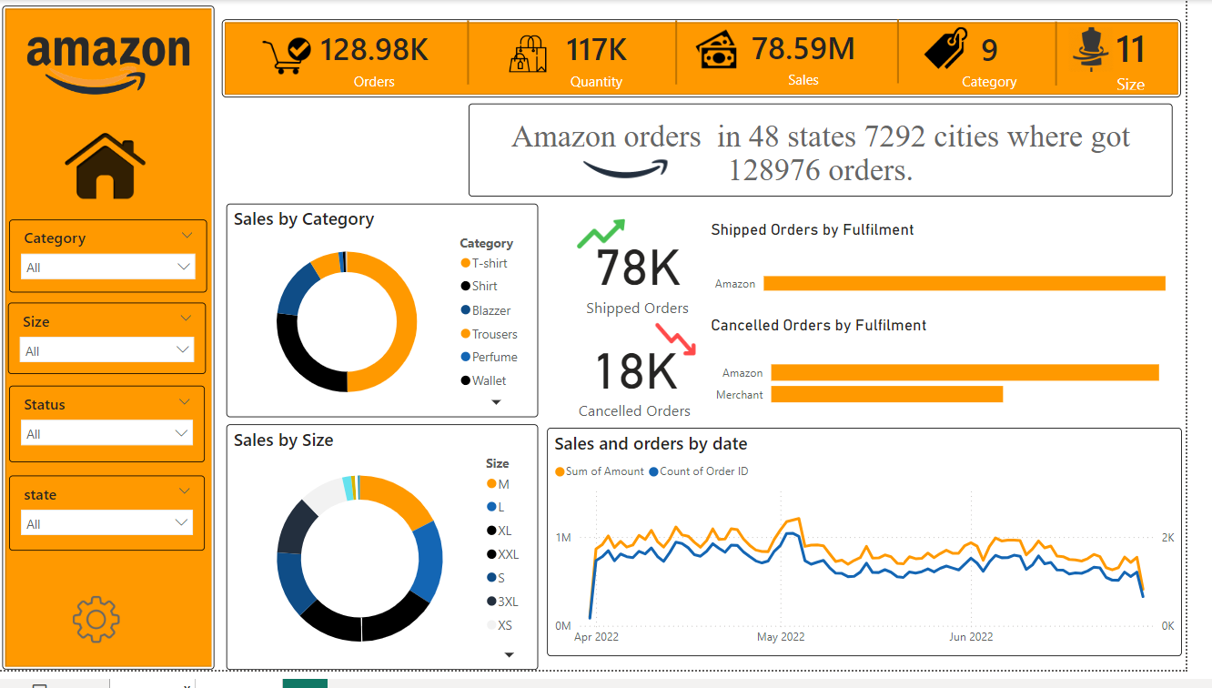
Notes:
Source images : https://unsplash.com/photos/aWf7mjwwJJo ( Medienstürmer on Unsplash )

Slide 8
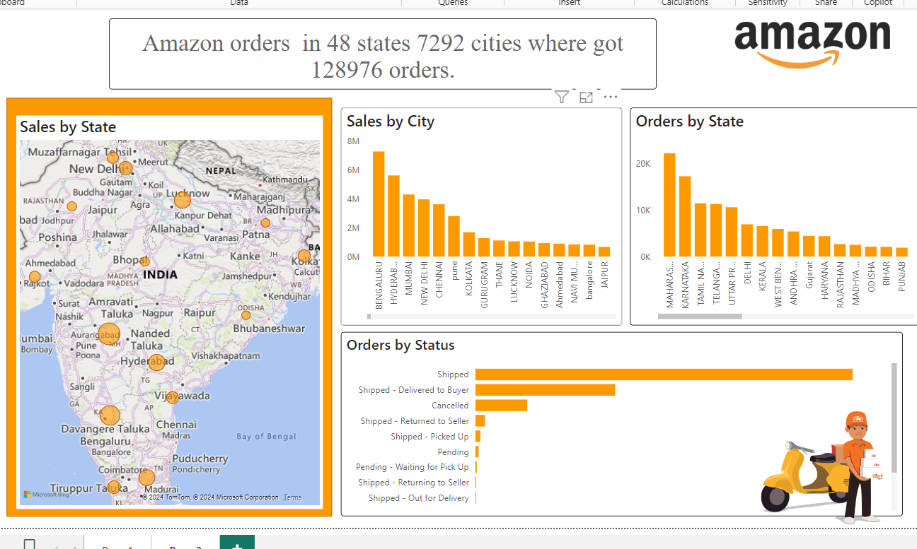

Slide 9
Recommendations
Targeted Marketing Campaigns:
Focus on promoting best-selling products like T-shirts and popular sizes like M.
Use data-driven insights to create personalized marketing campaigns for different customer segments.
Seasonal Promotions:
Replicate successful strategies from May in other months.
Offer discounts and bundles during peak sales periods and festive seasons.
Expand Product Range:
Introduce new products within popular categories to attract repeat customers.
Analyze customer preferences and trends to add new sizes and styles.
Customer Feedback:
Implement a robust system for collecting and analyzing customer feedback.
Address common issues and complaints promptly to improve customer satisfaction

Slide 10


Outcomes
The through analysis of the Amazon sales report aims to provided valuable insights that can be used to optimize business operations, enhance customer experience, and drive revenue growth. The analysis should offer actionable recommendations tailored to the specific needs and challenges of the business.
Save
Notes:
Source images : <a href='https://www.freepik.com/photos/business'>Business photo created by drobotdean - www.freepik.com</a>

